Slide 1


CSE AIML “C”
PRESENTATION
DIABETES PREDICTION
PRESENTED BY : GROUP 14
PREETI TIWARI
SAKSHI
SAKSHI KUMARI
SAUMYA SHARMA
VISHESH AGRAWAL

Slide 2

INDEX
01
Introduction
05
Tools & Library Used
Problem Statement
06
Visualization
02
Dataset Overview
03
07
Output/Result
Methodology
Challenges Faced
04
08
02

Slide 3
DIABETES PREDICTION
INTRODUCTION
Role of AI in Healthcare
Purpose of This Project
Artificial Intelligence (AI) have revolutionized healthcare by enabling early disease detection and data-driven clinical decisions. These technologies can analyze complex health data to uncover patterns that help in accurate diagnosis and prediction. By automating the prediction of diseases like diabetes,
This project specifically focuses on applying classification algorithms to predict whether an individual is likely to develop diabetes. Using a dataset of various medical attributes, we aim to create a model that assists in early prediction, ultimately contributing to better health outcomes.
03

Slide 4

DIABETES PREDICTION
04
PROBLEM STATEMENT
Diabetes is a chronic condition affecting millions worldwide. Early prediction can significantly improve treatment outcomes and quality of life. The goal of this project is to create a machine learning model that accurately predicts diabetes based on health data using classification techniques.

Slide 5
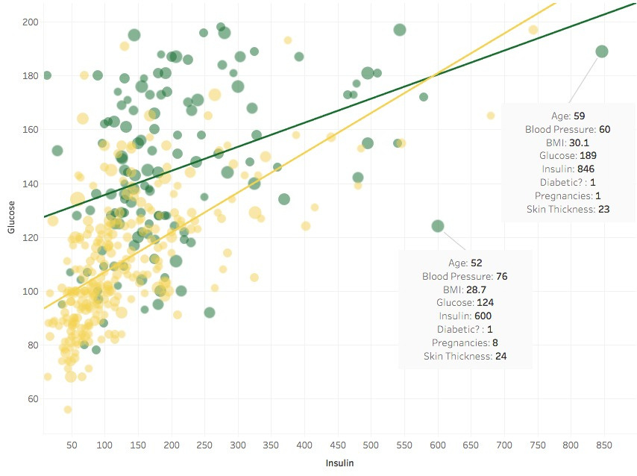
DIABETES PREDICTION
DATASET OVERVIEW
The dataset used is the Pima Indians Diabetes Database, sourced from Kaggle. It contains diagnostic measurements for 768 women of Pima Indian heritage aged 21 years and older
Pregnancies
BMI
01
04
Blood Pressure
Insulin
02
05
Skin Thickness
05
Glucose
03
05

Slide 6
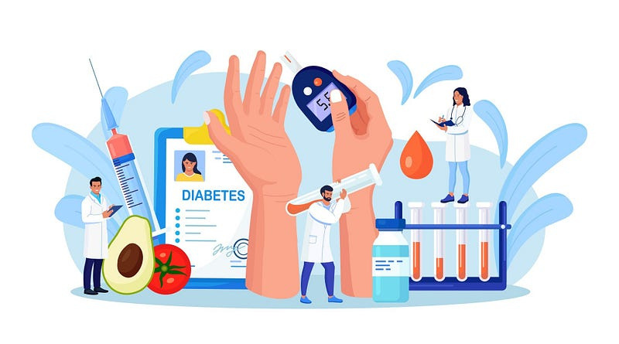


DIABETES PREDICTION
06
DATA PREPROCESSING
80%
Handled missing and zero values in critical features like Glucose, Blood Pressure, and Insulin.
Replaced zero values with median values.
Random Forest does not require feature scaling, so normalization/standardization was not applied.
Checked for data imbalance and split the dataset into training and testing sets using an 80-20 ratio.
20%

Slide 7
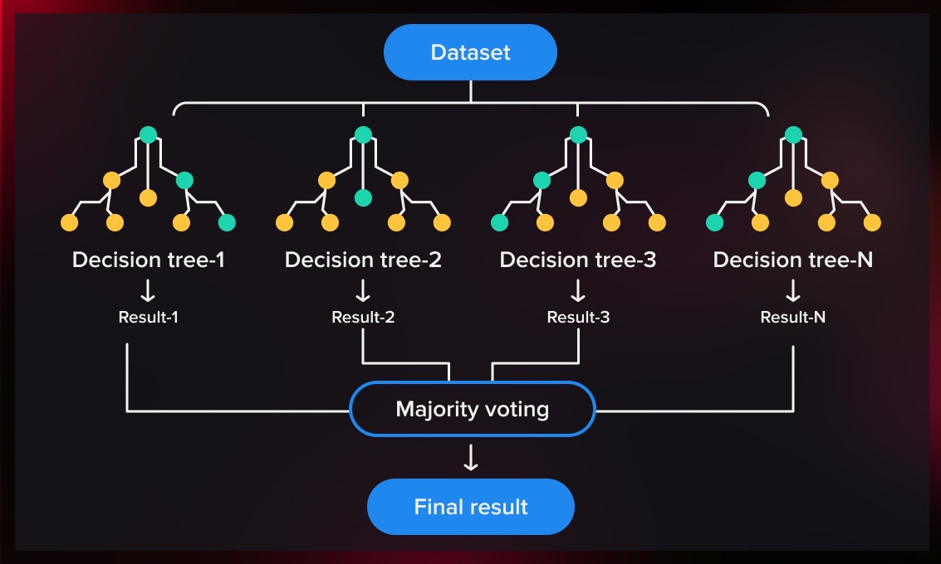
DIABETES PREDICTION
RANDOM FOREST CLASSIFIER
Random Forest is an ensemble learning method that builds multiple decision trees and merges them together to get a more accurate and stable prediction.
It handles both classification and regression tasks and performs well on large datasets with higher dimensionality.
Steps:
Fit the model on training data.
Predict outcomes on test data.
Evaluate model using classification metrics.
Tune hyperparameters (e.g., number of estimators, max depth) for improved performance.
07

Slide 8
DIABETES PREDICTION
TECH STACK &DATA
Tools and Libraries Used
Visualization of Dataset
Pandas, NumPy: Data handling
Matplotlib, Seaborn: Data visualization
Scikit-learn: Model building and evaluation
Google Colab/Jupyter Notebook: Development environment
Histograms of Glucose, BMI, Age distribution
Heatmap showing feature correlation
Count plot of Diabetic vs Non-Diabetic outcomes
08

Slide 9
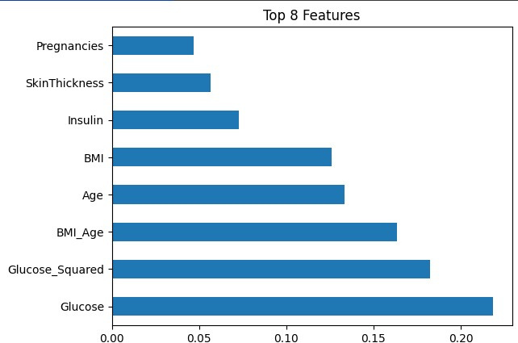
DIABETES PREDICTION
OUTPUT/
RESULT
Model Accuracy:
Random Forest Classifier: ~82%
Random Forest performed the best due to its ensemble nature and robustness against overfitting and noise in the dataset.
Metrics Used:
Accuracy: Correct predictions over total predictions
Precision: True Positives / (True Positives + False Positives)
Recall: True Positives / (True Positives + False Negatives)
F1 Score: Harmonic mean of precision and recall
09

Slide 10
DIABETES PREDICTION
CHALLENGES & SCOPE
Challenges Faced
Fututre Scope
Missing or zero values in medical records
Balancing model complexity with accuracy
Feature selection for improving prediction
Avoiding overfitting while tuning hyperparameters
Use advanced models like XGBoost or Neural Networks
Expand dataset with real-time medical data
Integrate model into mobile or web-based diagnostic tools
10

Slide 11

DIABETES PREDICTION
THANK YOU
The diabetes prediction model demonstrated the power of machine learning in healthcare diagnostics. Random Forest showed the highest accuracy and is suitable for further use. Early prediction through ML can assist doctors in timely intervention.
PRESENTED BY : GROUP 14

